Slide 1
Pre-Amendment Court Cases
Samhita Som
the India Maternity Act Amendment 2017

Slide 2
FOREWORD
The Indian Maternity Benefit Act of 1961, was amended in 2017. It is meant to regulate the employment of women before and after childbirth and provides maternity benefits.
This report reviews the employment conditions of pregnant women before the 2017 amendment as evidenced through important court cases.
MATERNITY BENEFIT ACT IN INDIA

Slide 3
Categories of Maternity Benefit Court Cases
Prior to 2017
Termination of Employment & Payments on account of maternity
Denial of Regular Leave on account of maternity
Illegal Service Rules

Slide 4
Index of Court Cases with Categories
Termination of Employment & Denial of Payments Air India vs Nargesh Meerza and Ors, 1981 (Supreme Court of India) Bombay Labour Union vs International Franchises Pot Ltd, 1965 (Supreme Court of India) K Chandrika vs Indian Red Cross Society, 2006 (Delhi High Court) Rattan Lal and Ors vs State of Haryana and Ors, 1985 (Supreme Court of India)
Denial of Regular Leave 5. Tata Tea Ltd vs Inspector of Plantations, 1990 (Kerala High Court) 6. B Shah vs Presiding Officer, Labour Court, Coimbatore and Ors, 1977 (Supreme Court of India)
Illegal Service Rules 7. Smt Neetu Choudhary vs State of Rajasthan and Ors, 2005 (Rajasthan High Court) 8. Vandana Kandari vs University of Delhi, 2010 (Delhi High Court)

Slide 5
Case #1: Air India vs Nargesh Meerza and Ors, 1981
Nature of Petition: In this case, many Air Hostesses of Air India sued their employer because of a company rule in which a Hostess would be fired or terminated if she became pregnant
Court Order: The Court ruled that this provision was unreasonable and violates Article 14 of the Indian Constitution

Slide 6
Case #2: Rattan Lal and Ors vs State of Haryana and Ors, 1985
Nature of Petition: In this case, government-employed teachers in the state of Haryana were unhappy because they did not receive many benefits, including maternity leave and other maternity benefits
Court Order: The Court mandated that maternity benefits and leave be given to the teachers of Haryana

Slide 7
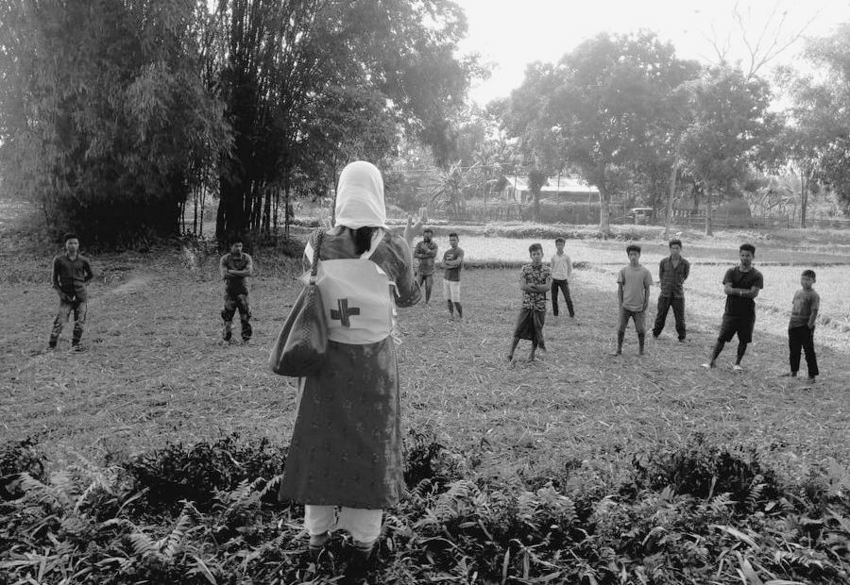
Case #3: K Chandrika vs Indian Red Cross Society, 2006
Nature of Petition: In this case, the petitioner’s employment at the Indian Red Cross was terminated during her maternity leave, and she was also denied reinstatement and benefits.
Court Order: The Court ruled that her job was terminated illegally, and ruled that the Petitioner must be given her position back

Slide 8
Case #4: Bombay Labour Union vs International Franchises Pot Ltd, 1965
Nature of Petition: In this case, an employment policy of International Franchises Pot Ltd stated that upon marriage, a woman would be terminated from her job within the company.
Court Order: The Court struck down this rule because they noted that there was no indication that the performance of a married women would be different than that of an unmarried woman or a widow. It ruled that there is no justification for a rule ,of this kind which requires an unmarried woman to give up service immediately she marries.

Slide 9
Case #5: Tata Tea Ltd vs Inspector of Plantations, 1990
Nature of Petition: In this case, the Inspector of Plantations stated that many practices of the defendant, Tata Tea Ltd, were unconstitutional.
Court Order: The Court stated that if a woman is currently under maternity leave, then her employer cannot make her work on holidays. In addition, the court held that the money a woman makes under the National and Festival Holiday Act cannot be combined with the money she is entitled to under the Maternity Benefit Act.

Slide 10
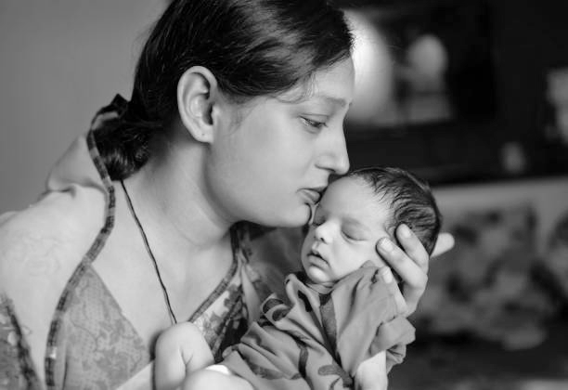
Case #6: B Shah vs Presiding Officer, Labour Court, Coimbatore and Ors, 1977
Nature of Petition: This case involved a discrepancy of whether Sundays, on which day workers are not paid, could be excluded whilst calculating the mandated government maternity benefits paid to her in the time period of 12 weeks
Court Order: The Court ruled in favor of the Petitioner, and ordered her company to pay her for the 12 Sundays in her maternity leave

Slide 11
Case #7 Smt Neetu Choudhary vs State of Rajasthan and Ors, 2005
Nature of Petition: The Petitioner in this case was a government worker who was denied maternity leave based on the account that she was on a contract-based consolidated salary, and was therefore not entitled to maternity benefits
Court Order: The Court determined that one cannot withhold maternity benefits to female employees based on the the nature of their employment.

Slide 12
Case #8: Vandana Kandari vs University of Delhi, 2010
Nature of Petition: In this case, The University of Delhi reprimanded the Petitioner on the grounds that she did not attend classes . However, at the time she was in an advanced state of pregnancy and unable to attend the classes
Court Order: The Court ordered that no college or university can hold it against a woman to not attend classes if she is unable to attend due to pregnancy

Slide 13
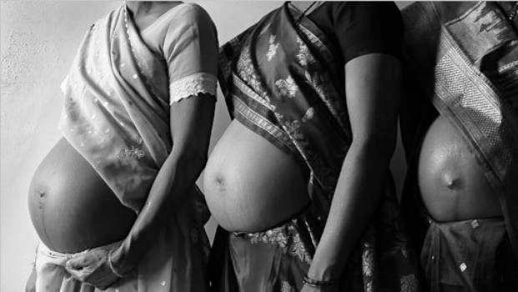
Conclusion
somsamhita@gmail.com
Samhita Som
The many landmark court cases reviewed in this study, clearly reveal the trials & discrimination that Indian women went through, prior to the 2017 amendment.
It is commendable that the Govt of India recognized the fact, that the MB Act 1961 was sorely overdue for an overhaul, if India were to achieve its mission of improving Global Ease of Doing Business rankings, in which labour rights are an important parameter.

